Slide 1


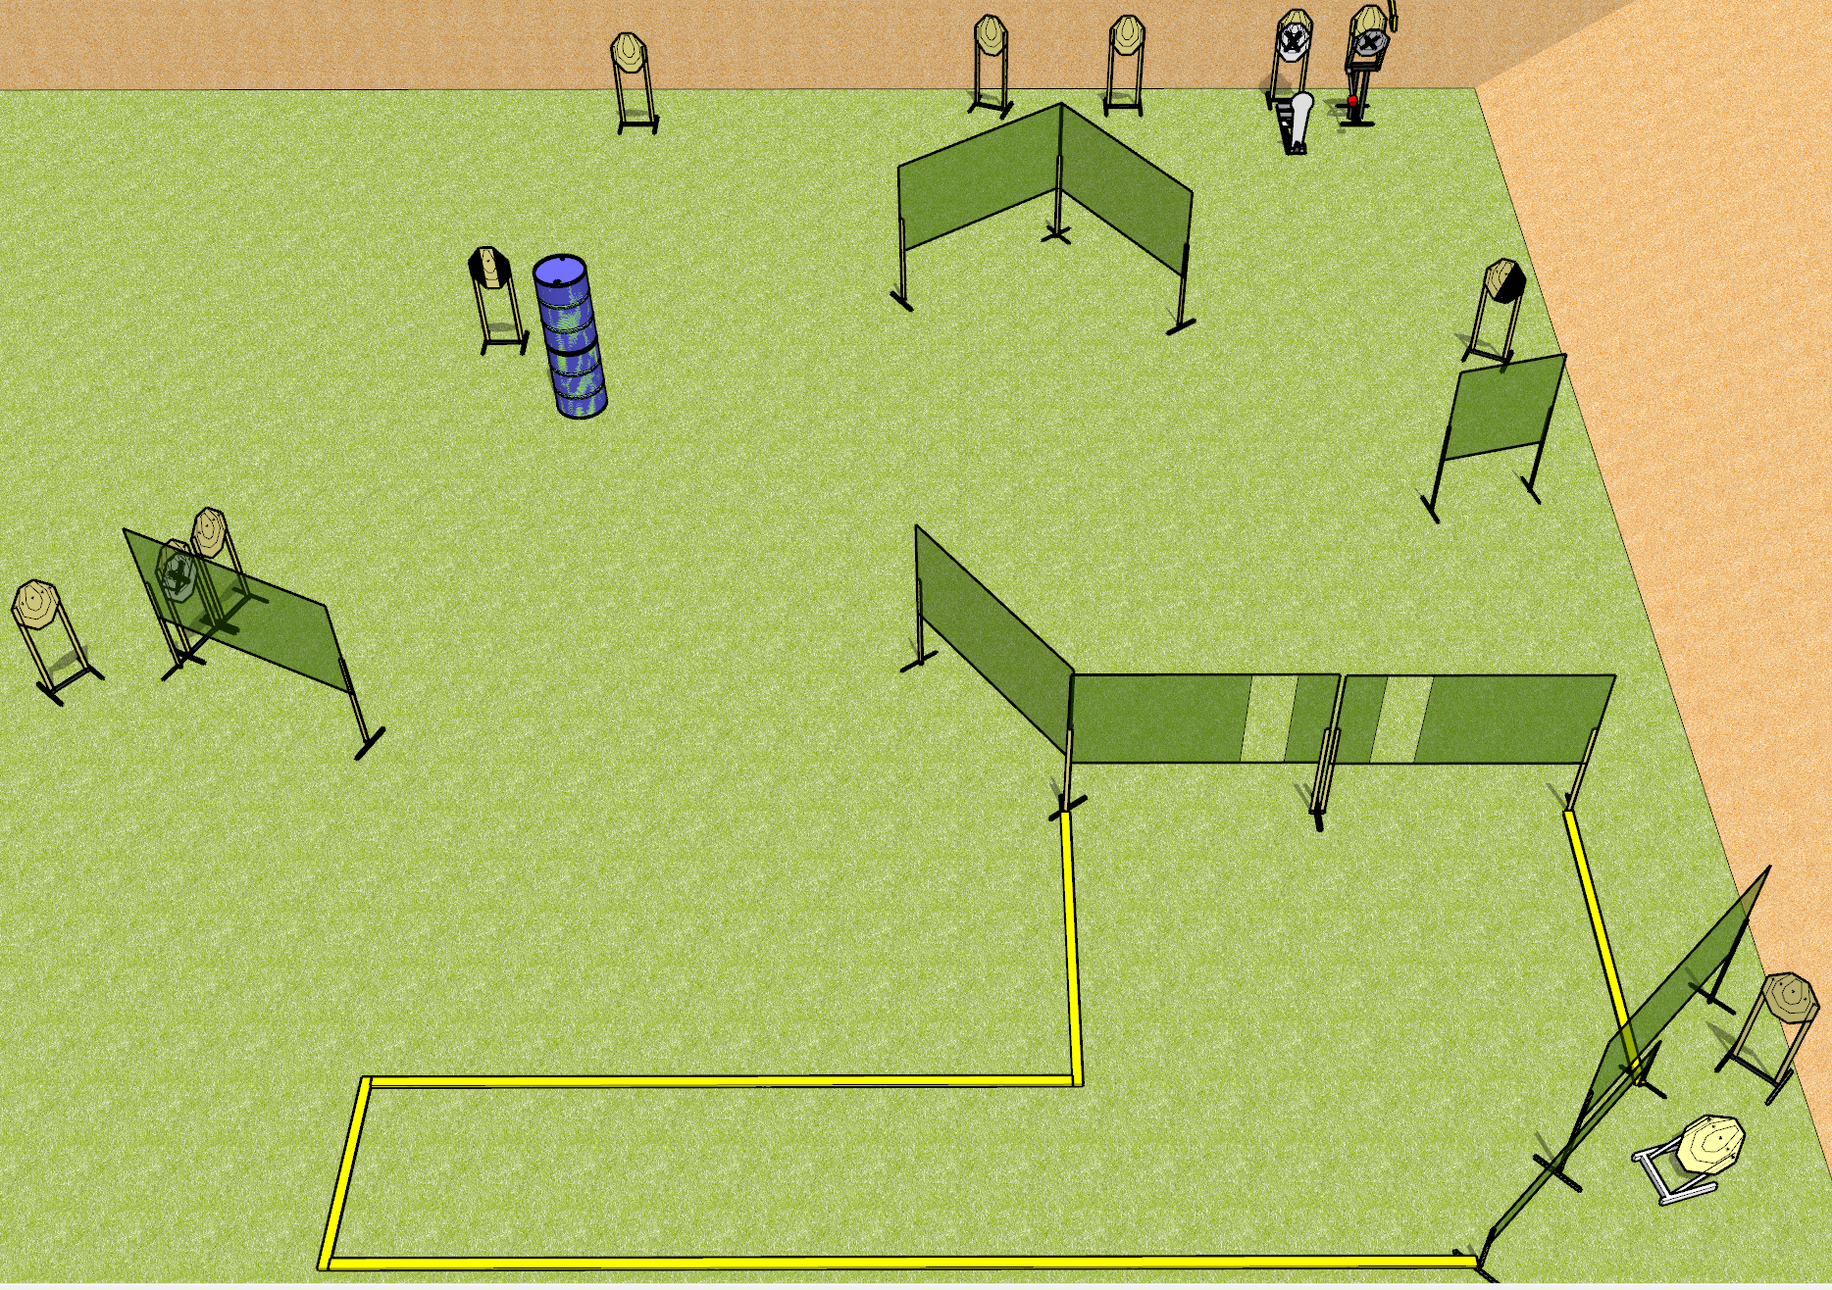
 | Dothan Gun Club – USPSA Match String it Together Course Designer : Drew Coleman
Round Count 25 rounds 12 IPSC 1 colt popper
Equipment List 16 wall feet 1 medium fault line Max trap + activator 1 tux, 1 right diagonal

Slide 2
String it Together
Written Stage Briefing
String it Together is a 25 round, 125 point, Comstock course of fire. There are 12 IPSC targets and 1 colt popper. The best 2 hits on paper will score, and steel must fall to score. The start signal is audible.
The max trap is activated by the colt popper and remains visible at rest.
Handgun start position is anywhere completely outside the shooting area, wrists below belt. Pistol is UNLOADED and holstered.
PCC start position is anywhere completely outside the shooting area, stock on belt. UNLOADED carbine is held with both hands.
On start signal, engage targets as they become available from within the shooting area.

